Slide 1


Explainable AI for Risk Stratification and Intervention Optimization in Maternal Health:
A Focus on Adolescent Pregnancies and Intrapartum Complications

Slide 2
BACKGROUND
Maternal mortality remains a critical global health challenge, disproportionately affecting adolescent mothers in low and middle-income countries(1). Sub-Saharan Africa bears the highest burden, with young mothers facing elevated risks of life-threatening complications such as preeclampsia, obstructed labor, and postpartum hemorrhage (2). Traditional predictive tools often lack interpretability, limiting their clinical adoption in resource-constrained settings.

Slide 3
PROBLEM STATEMENT
Every day, 810 women die from preventable causes related to pregnancy and childbirth, with 66% of these deaths occurring in Sub-Saharan Africa (WHO, 2023). In countries like Nigeria and Kenya.
Haemorrhage, hypertensive disorders, and unsafe abortions account for over 60% of maternal mortality, exacerbated by delayed emergency care and limited ANC access (UNFPA, 2022).

Slide 4
OBJECTIVES
To develop an explainable AI (XAI) framework for maternal health that enables:
Accurate maternal health risk prediction
Provides clinically interpretable decision support, and
Delivers actionable guidance with a focus on adolescent pregnancies, WHO-aligned intervention guidance(3) to improve maternal outcomes in diverse healthcare settings.

Slide 5
SOLUTION
A context-aware, explainable AI system that:
Flag high-risk pregnancies early (especially adolescent mothers, 10- 19 years).
Prioritises actionable interventions (e.g., oxytocin access, emergency referral).
Adapts to Africa’s resource constraints (works offline, integrates with mobile CHW tools).

Slide 6
METHODOLOGY
A dataset of 222 maternal health cases from Kenyan health facilities (4) was used to implement machine learning models (XGBoost, Random Forest, Logistic Regression) enhanced with SHAP and LIME for interpretability.
Class imbalance was addressed via SMOTE oversampling and undersampling.
Key features included antenatal care visits, adolescent pregnancy status, and uterotonic administration. Models were evaluated using precision-recall AUC, F1-score, and cross-validation.

Slide 7
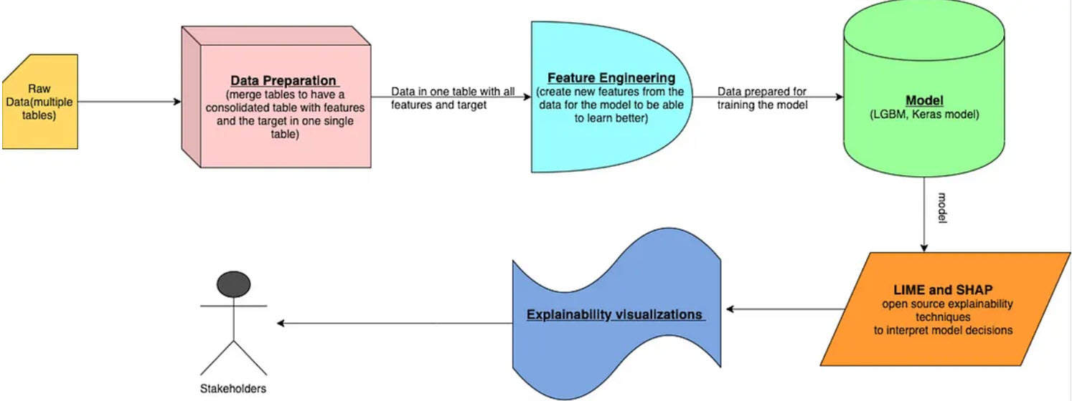
FRAMEWORK

Slide 8
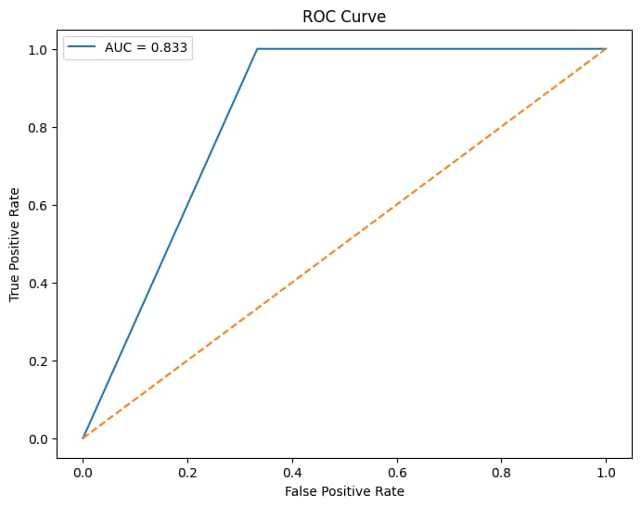
RESULT
S/No | Models | F1 score | Recall | Precision
1 | Random Forest | 1.00 | 1.00 | 1.00
2 | XGBoost | 1.00 | 1.00 | 1.00
3 | Decision Tree | 0.95 | 0.92 | 0.99
4 | Logistic Regression | 0.92 | 0.98 | 0.88
Cross-validation scores: 10-fold CV F1: 0.97 ± 0.02

Slide 9
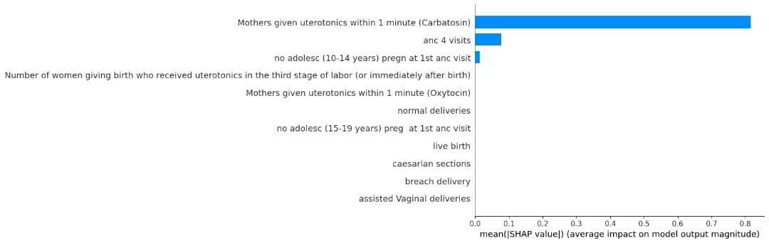
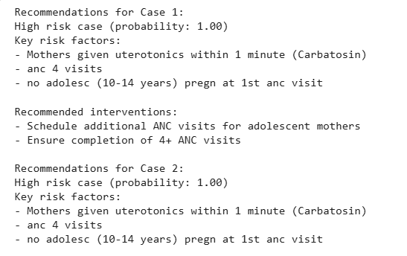
RESULT

Slide 10
RESULT
Tree-based models achieved perfect classification (100% accuracy), while logistic regression showed strong performance (97% accuracy).
SHAP analysis identified inadequate antenatal care visits, adolescent pregnancy, and delayed uterotonic administration as top risk factors.
The framework generated dynamic intervention recommendations, including ANC visit optimization (92% of cases) and adolescent-specific support (63%).

Slide 11
DISCUSSION
The XAI framework successfully bridges the gap between predictive accuracy and clinical interpretability. While tree-based models demonstrated flawless performance, their real-world applicability requires further validation due to potential dataset limitations. The system's ability to provide case-level explanations enhances trust and usability in clinical settings.

Slide 12
RECOMMENDATION
1. Critical Risk (Probability ≥80%):
  Immediate referral to specialist care.
  Oxytocin checklist for delivery staff.
2. Moderate Risk (40-79%):
  Extra ANC visits + nutrition counselling.
  Teen pregnancy support groups.

Slide 13
IMPACT AND SCALABILITY
Mobile app for community health workers.
Real-time alerts in hospital EHR systems.
Policy use: Target high-risk regions.

Slide 14
CHALLENGES
Small dataset (n=222) → Needs expansion.
Ethical AI: Avoiding bias against teen mothers.
Future Work:
IoT integration (BP monitors, wearable tech).
Multi-country validation.

Slide 15
CONCLUSION
This study presents a clinically interpretable AI system for maternal risk stratification, with particular relevance for high-risk adolescent populations in resource-limited settings.
"AI + Human Expertise = Fewer Maternal Deaths“
For clinicians: Use AI as a decision-support tool.
For policymakers: Invest in predictive maternal health.
For researchers: Collaborate on larger-scale trials.

Slide 16
REFERENCE
WHO 2023.
Ganchimeg et al. 2014
WHO Safe Childbirth Checklist 2024
Omondi et al. 2022

Slide 17
Q&A

Slide 18
THANK YOU

